Slide 1
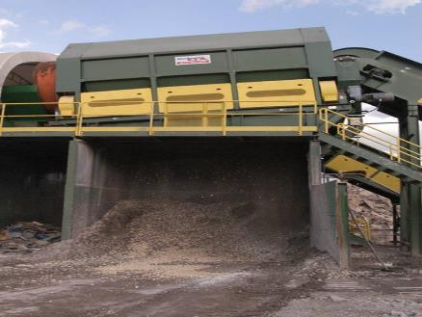
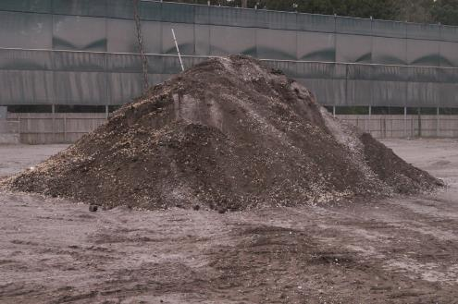
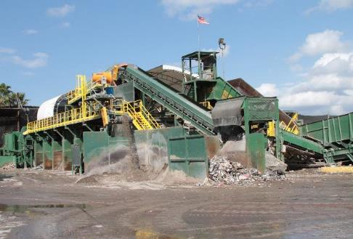
Enhancing Markets for Recovered C&D Derived Products: Opportunities with C&D Fines and Wood-Derived Biochar
Timothy G. Townsend, PhD, PE Neel Kalita, Yalan Liu, Jake Thompson Department of Environmental Engineering Sciences
Engineering School for Sustainable Infrastructure and Environment University of Florida
August 26, 2020
ttown@ufl.edu
http://townsend.essie.ufl.edu

Slide 2
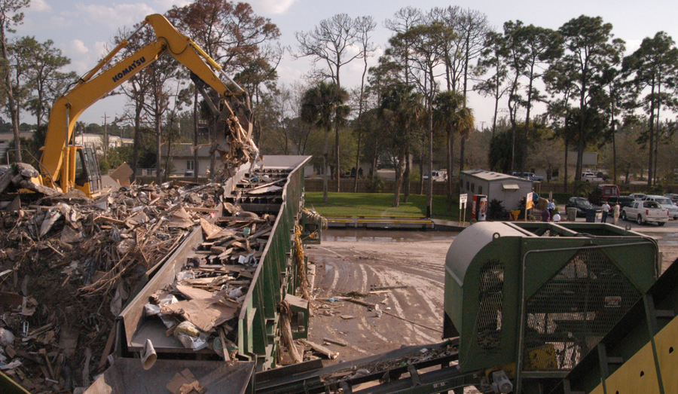
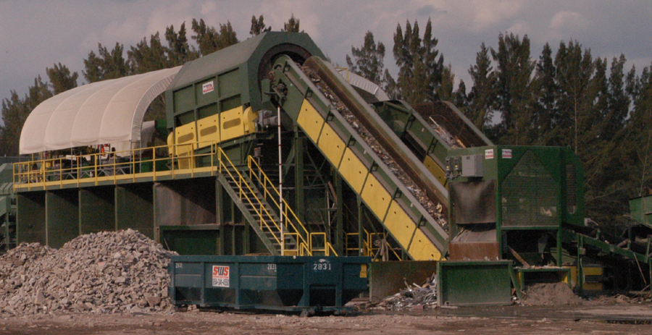
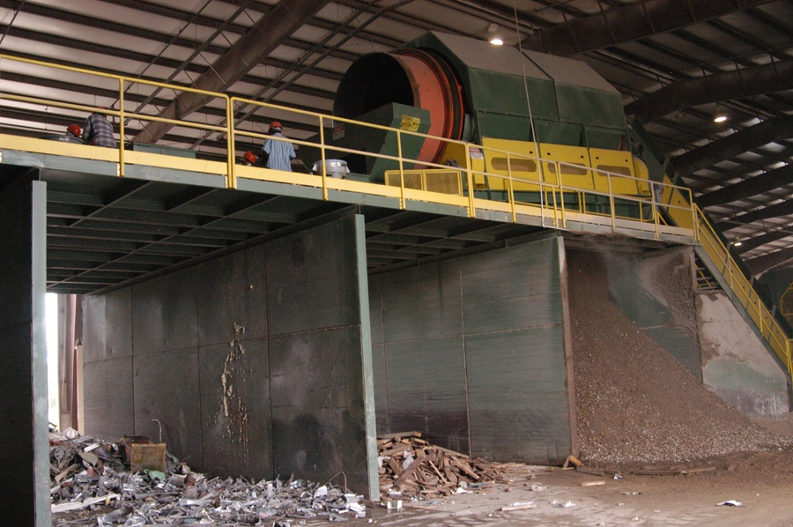
Major C&D Recovered Commodities
Aggregate
Wood
Fines
Metal
Cardboard
Gypsum Drywall
Asphalt Shingles
RDF

Slide 3
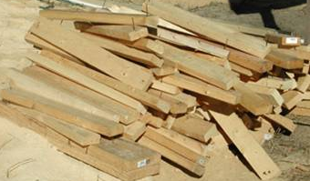
C&D Wood
Dimensional lumber
Pallets
Land clearing wood
Engineered wood
Plywood
MDF
OSB
Treated wood

Slide 4
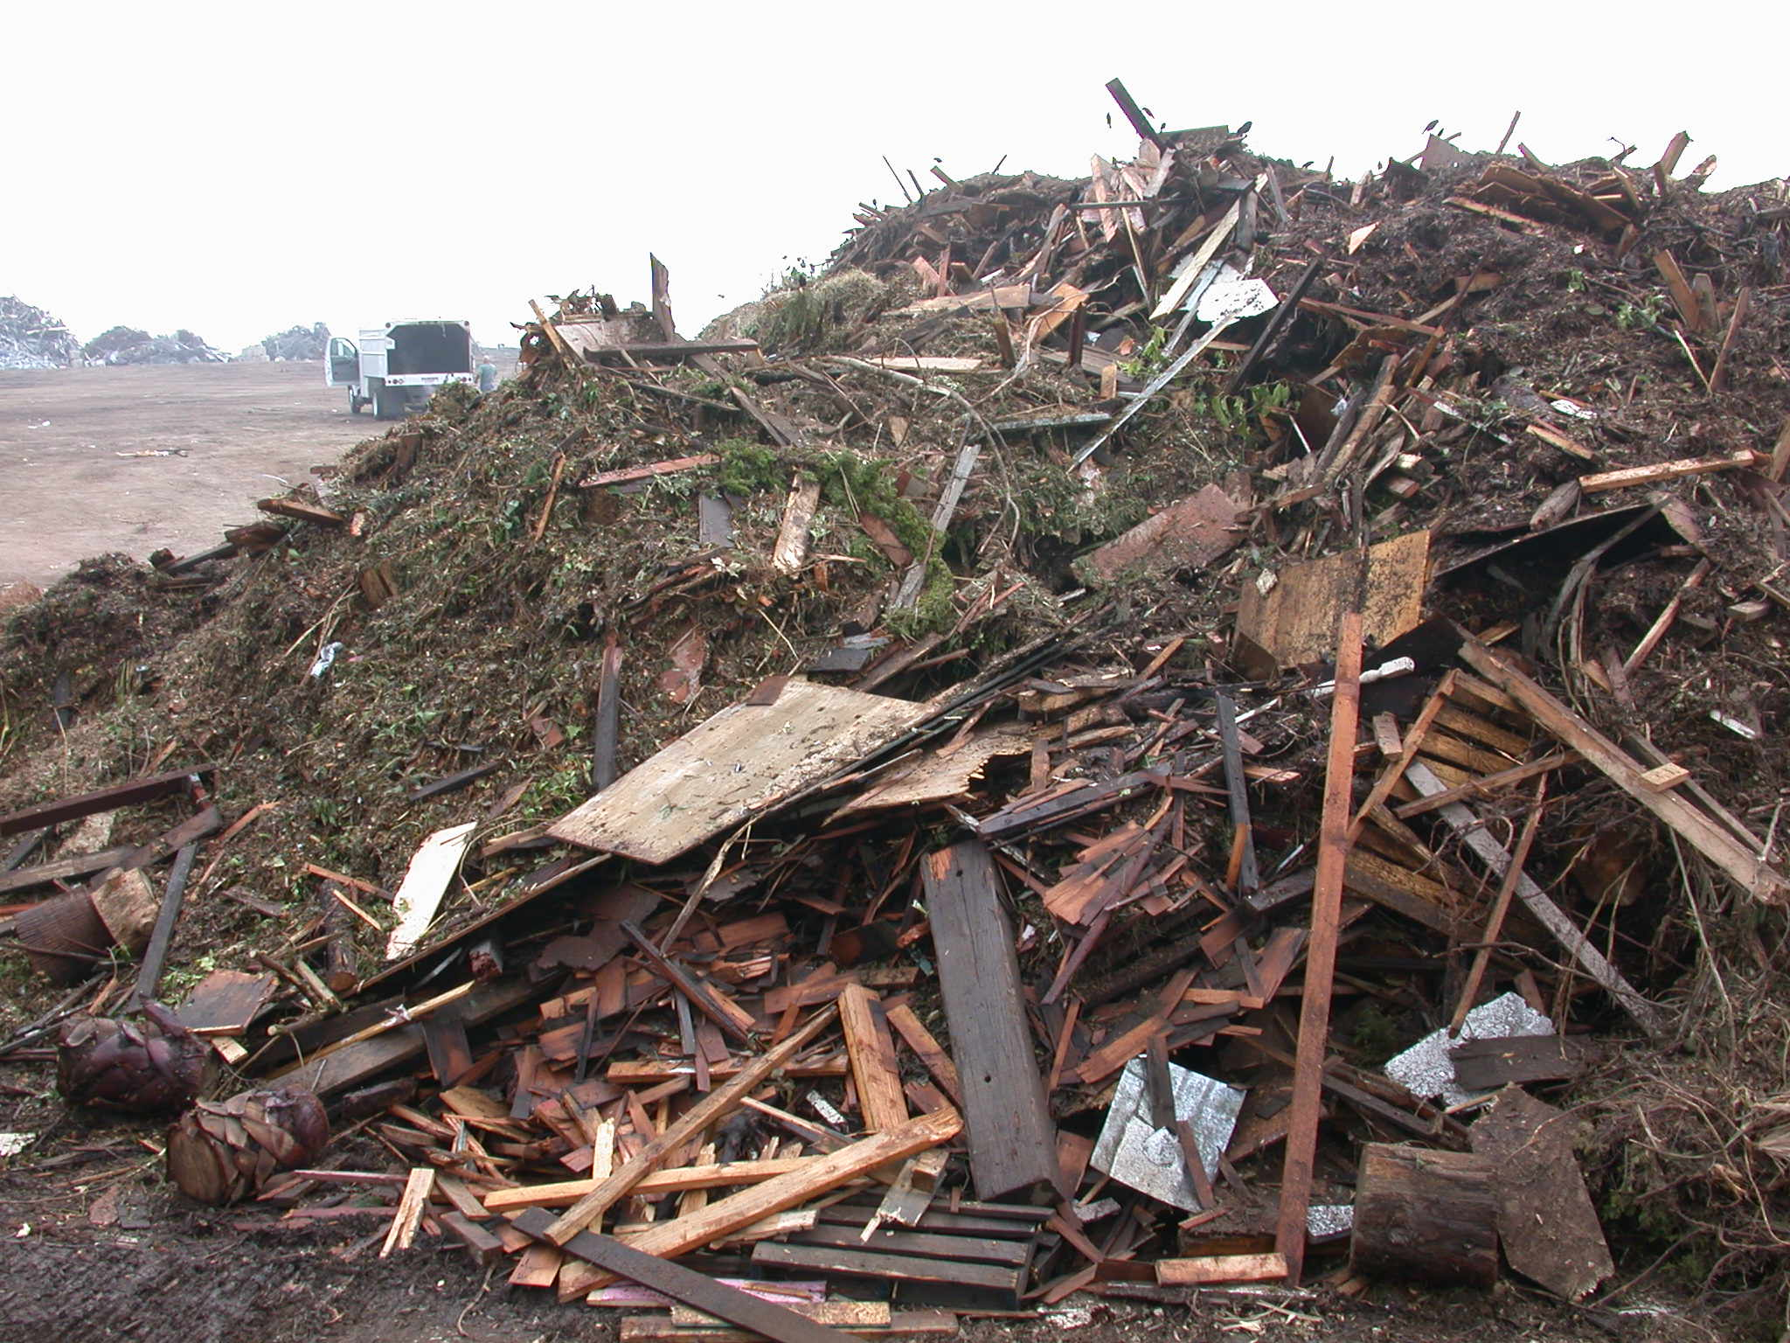
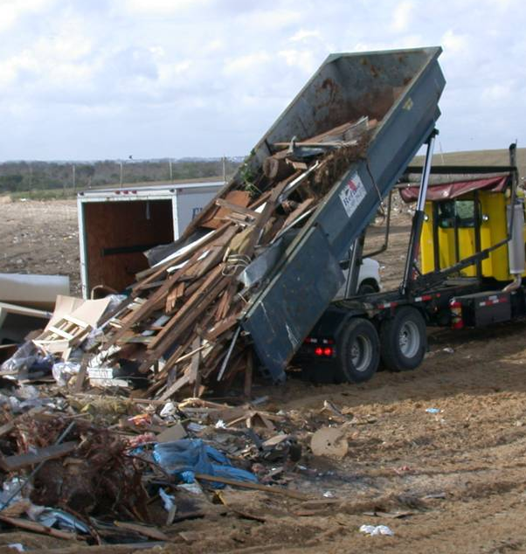
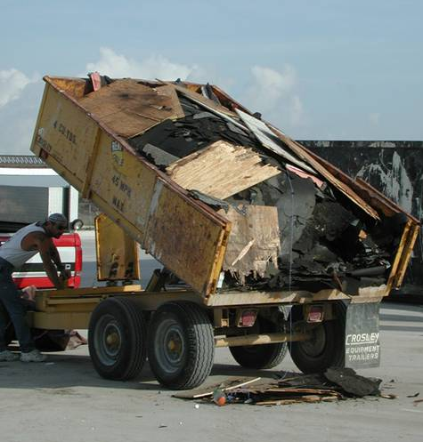

Slide 5
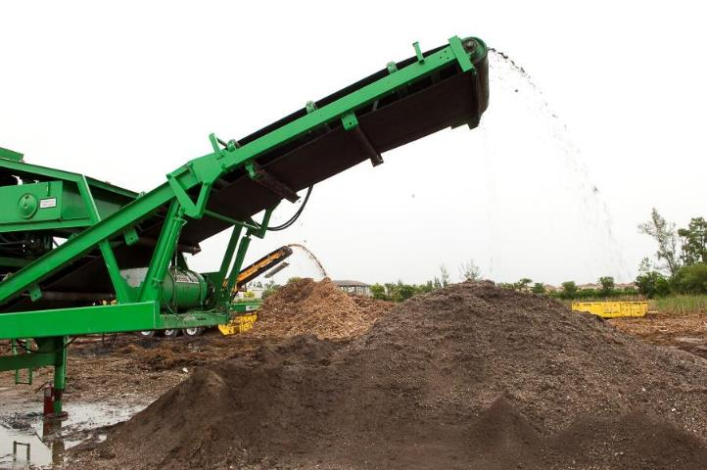
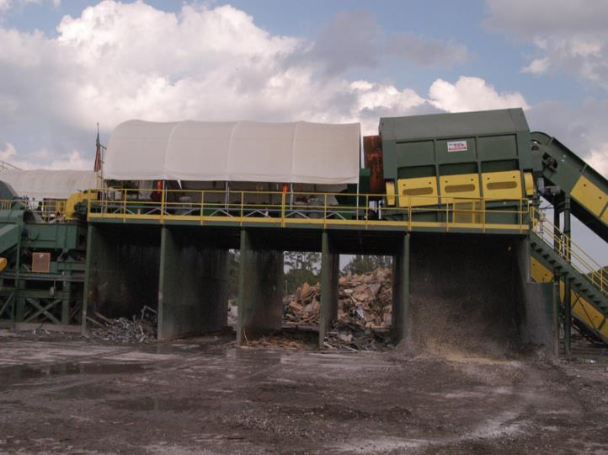
C&D Fines
Materials screened from the mixed CDD
Soil
Aggregate
Wood
Gypsum
Shingles
Depends on waste stream, materials removed, degree of processing
Size depends on screen size
Management options:
Reuse as alternative daily cover at landfills
Reuse outside of landfills
Major
Minor
Fines

Slide 6
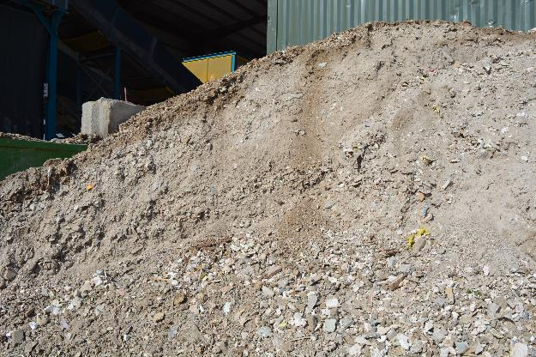
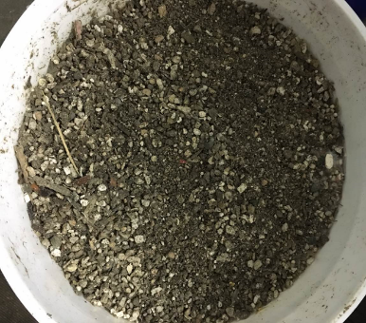
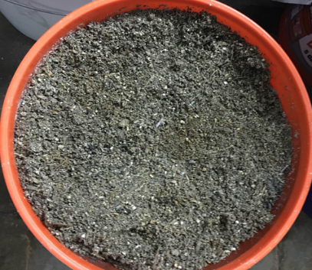
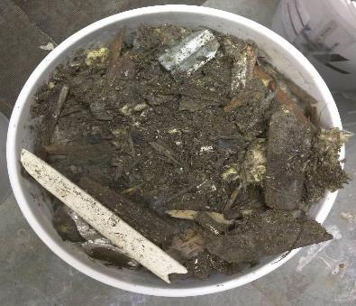

Slide 7
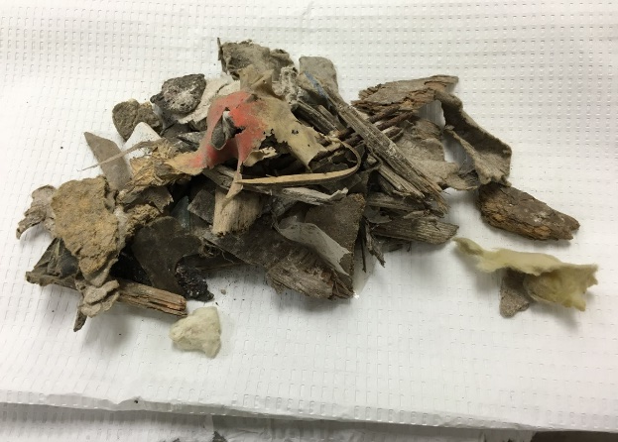
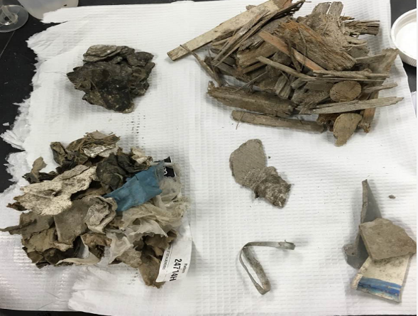
CDRA Fines Characterization Study
> 25 mm
19 mm – 25 mm

Slide 8
Potential Fines Markets and Issues
Will it suppress fires?
Will it cause odor?
Landfill Cover
Fill material
Soil/agricultural amendment
Meet fill needs?
Will it pose environmental risk?
Will it meet amendment needs?
Will it pose environmental risk?
Notes:
The bunkers underneath the picking line.

Slide 9
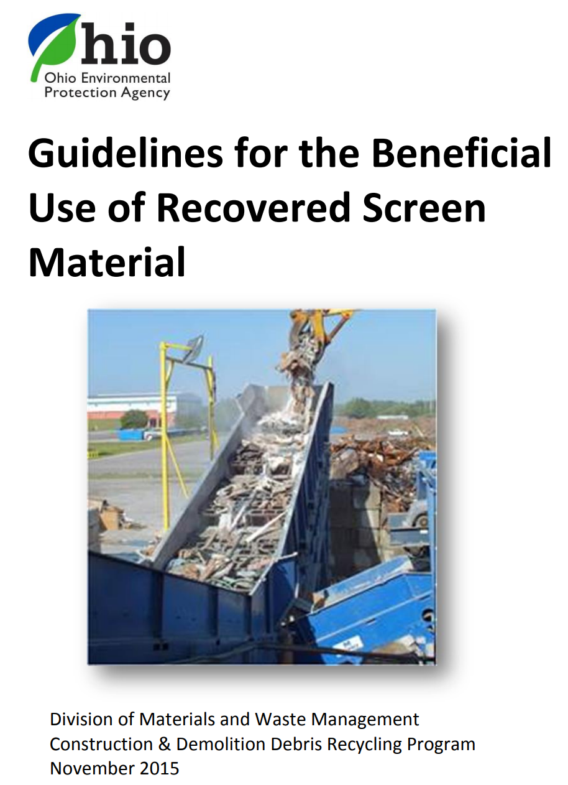
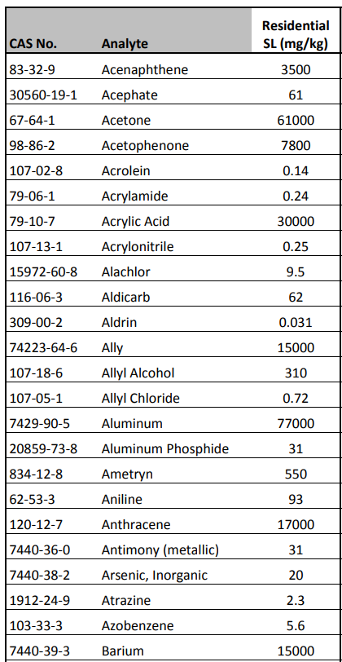
In some cases, beneficial use risk levels may already be provided for C&D fines

Slide 10
CDRA Fines Characterization Results
Most trace components were not found to be a concern.
Asbestos, PCBs, most metals
Four components emerge as levels of possible concern:
Arsenic
Lead
Benzo-a-pyrene (BAP)
Sulfate
Exposure concern
Landfill odor concern

Slide 11
Transitioning from Managing By-Products to Developing Products
Limitations often exist to the reuse of C&D fines
Opportunities to reduce pollutant concentrations:
Be more selective on the waste processed
Target specific size fractions
Washing
Blending
What about the gypsum drywall problem when the desired market is landfill daily cover?

Slide 12
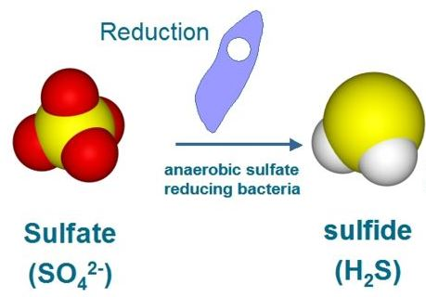
The Challenge of Gypsum Drywall in Landfills
Issues with Hydrogen Sulfide (H₂S)
Odor
Health and safety
Water
Gypsum
(CaSO₄●2H₂O)

Slide 13
Creating a Better Landfill Cover Product

Slide 14
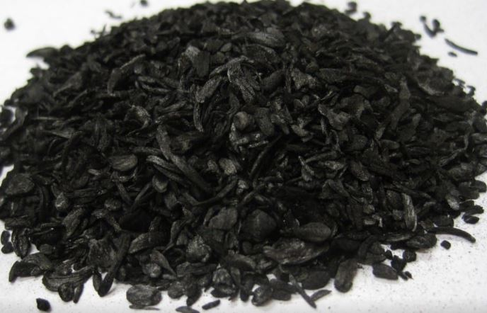
Biochar
Produced by pyrolysis of biomass under oxygen-limited conditions
Fine-grained and porous substances
Activated carbon and biochar is known to absorb H₂S

Slide 15
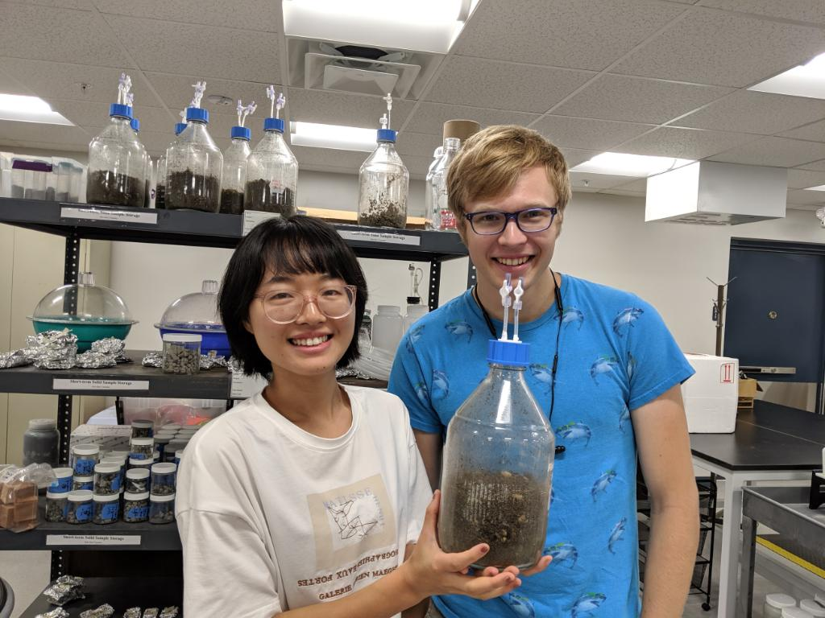
Proof of Concept Study
Objective: Explore whether addition of biochar could attenuate H₂S emissions from landfilled C&D fines
Approach: Mix biochar and C&D fines in simulated landfill reactors and measure H₂S generation

Slide 16
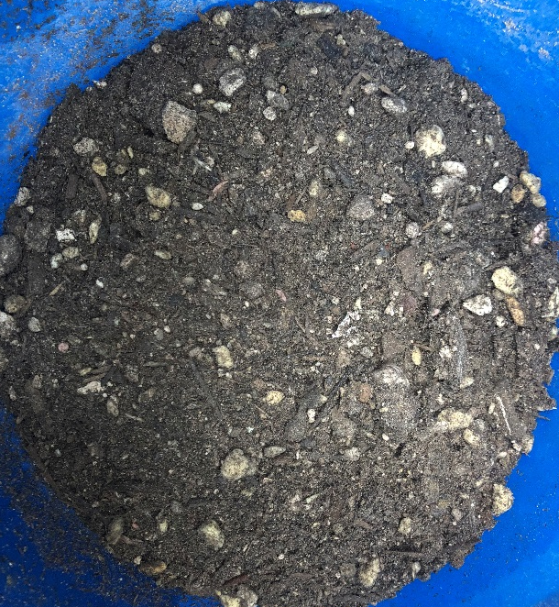
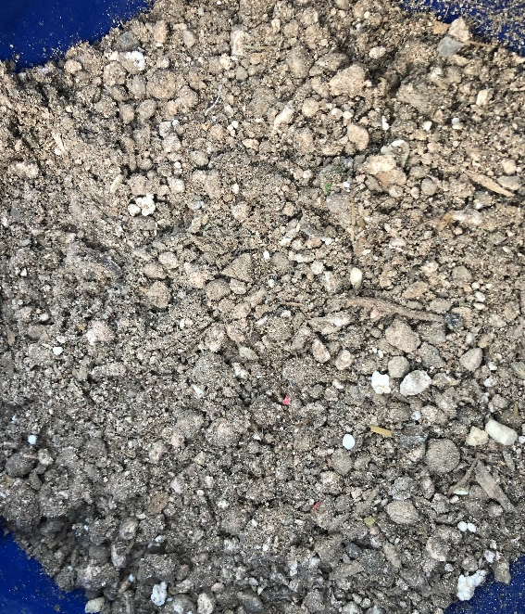
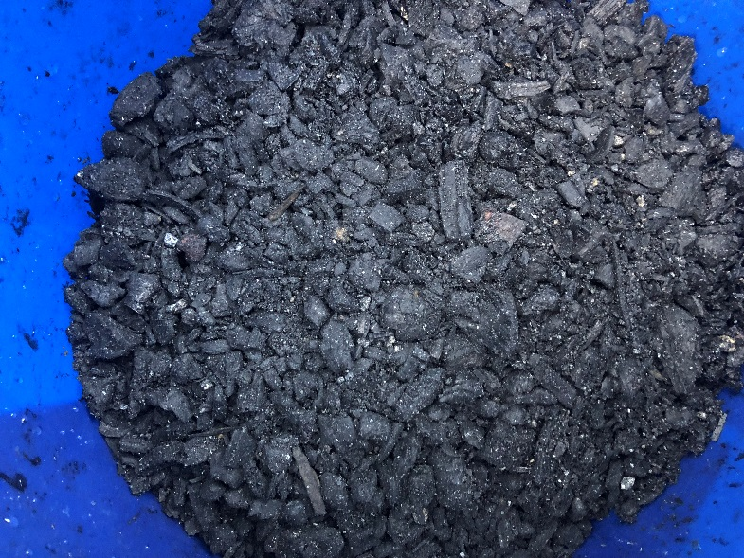
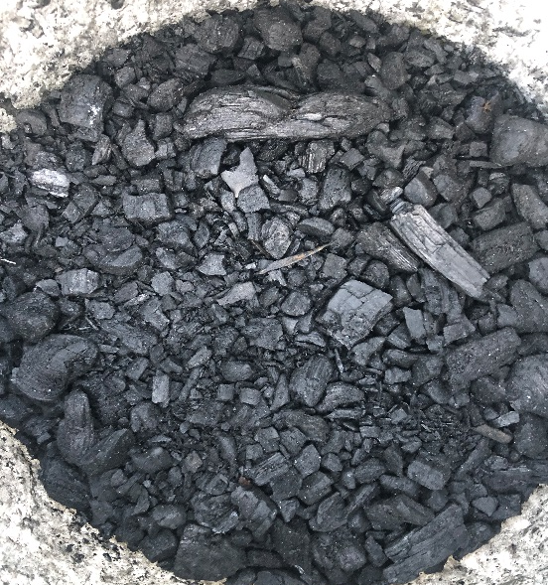
Materials
Two C&D fines
Two biochar samples
C&D fines 1
C&D fines 2
Biochar 1
Biochar 2

Slide 17
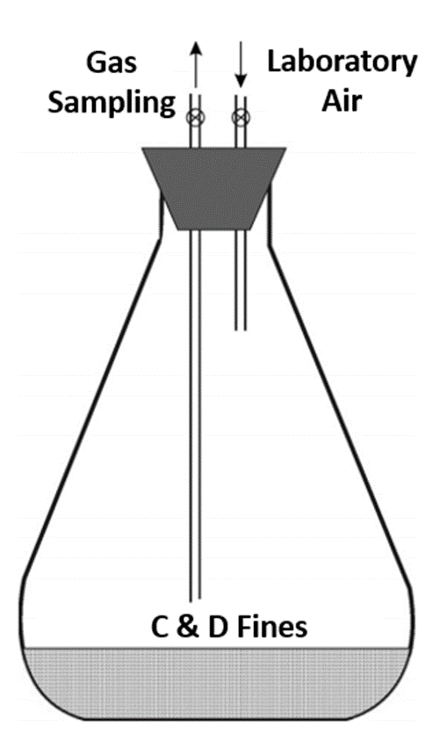
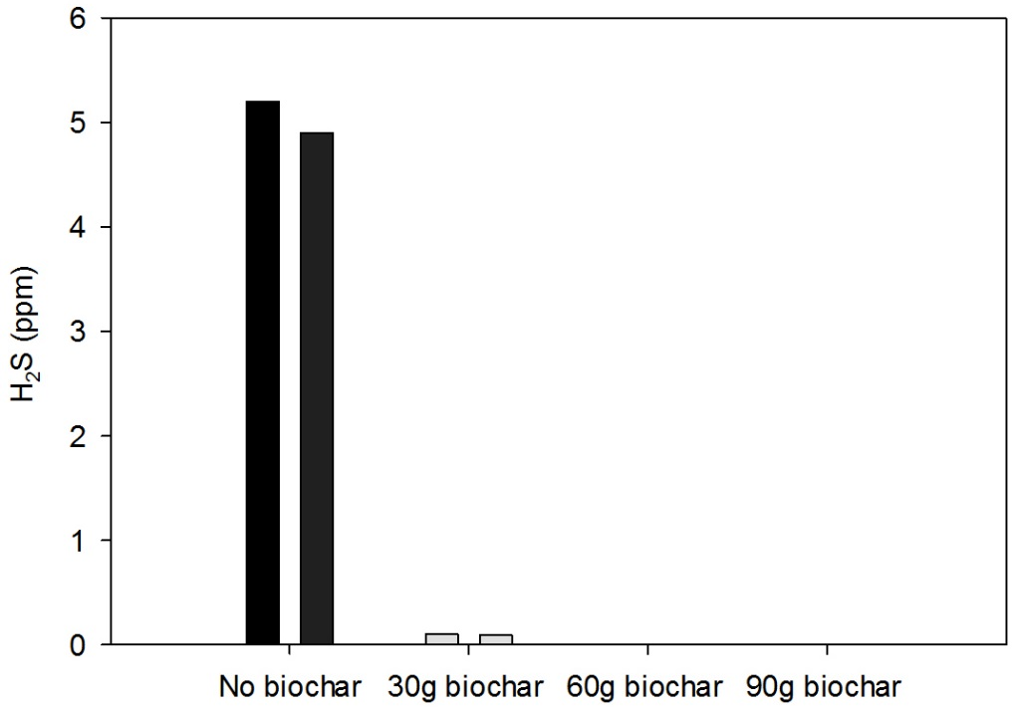
Preliminary experiment
250ml bottle
30g size reduced
biochar 2
30g size reduced
biochar 2
Store in dark for 3 days
100ml 25ppm H₂S
250ml bottle
Measure H₂S
60g size reduced
biochar 2
60g size reduced
biochar 2
250ml bottle
90g size reduced
biochar 2
90g size reduced
biochar 2
250ml bottle
Notes:
Basic mechanical processing operation

Slide 18
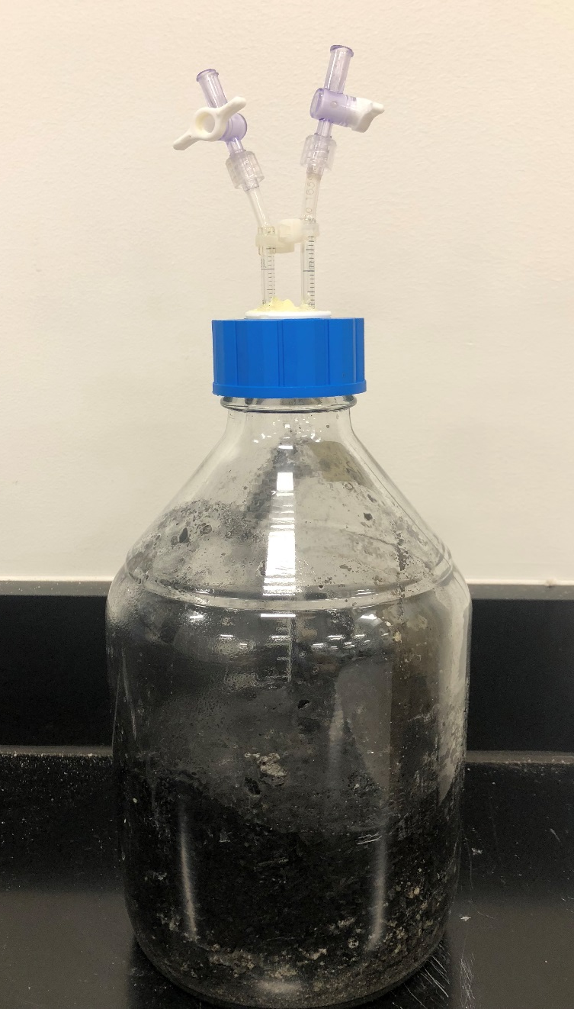
Experimental flask
Sampling / nitrogen flushing valves
Twist seal cap with two valve slots
C&D fines, biochar and water

Slide 19
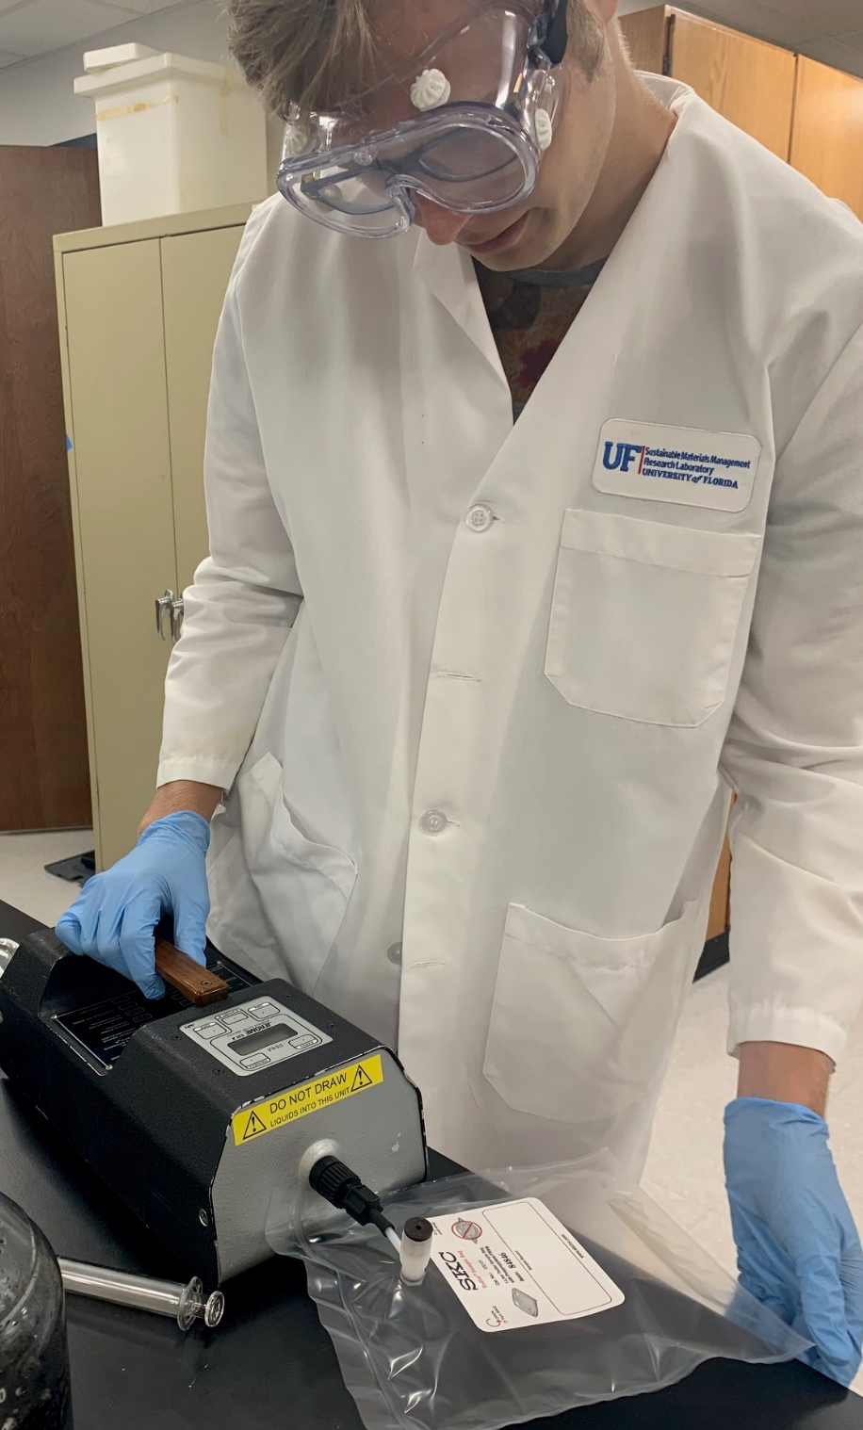
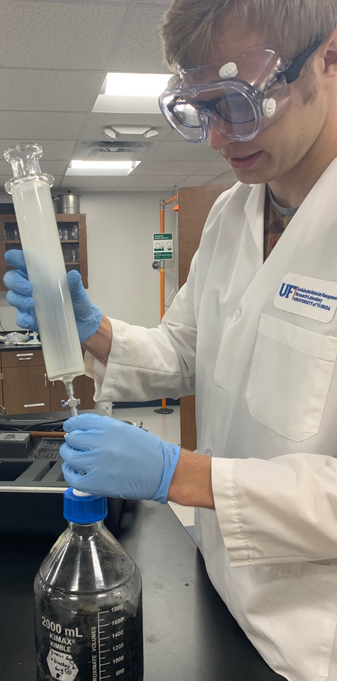
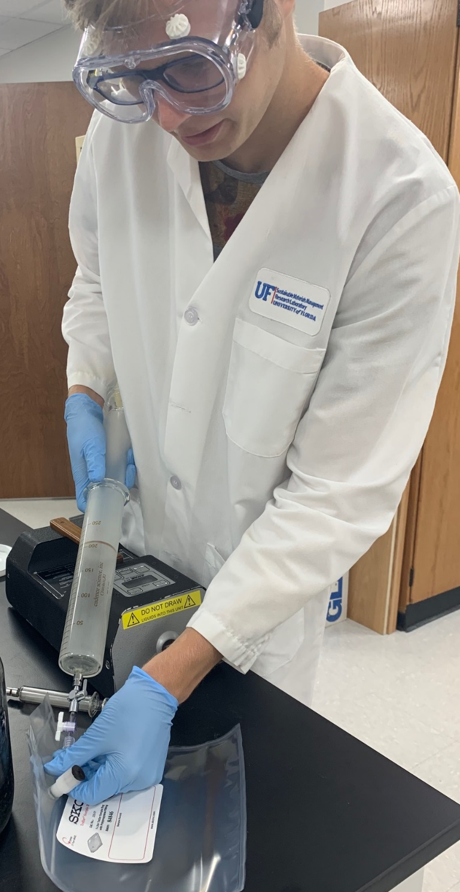
H2S measurement
Use a glass syringe to take H₂S out of flask
Inject the gas into a tedlar bag (dilute if necessary)
Measure the H₂S in the bag using a Jerome 631-X H₂S analyzer
The Jerome meter has a detection range of 0.003-50ppm
The H₂S was diluted using the lab air if higher than 50ppm
The Jerome meter was checked using a 25ppm H₂S standard gas before measurement

Slide 20
Results

Slide 21
Results

Slide 22
Results

Slide 23
Results

Slide 24
Results
C&D fines 2

Slide 25
Focused Research Effort for End Market Development
Determine the optimum approach or recipe for blending C&D fines and biochar in the laboratory
Validate with pilot and field studies

Slide 26
Summary
CDRA research has targeted market development for C&D materials; there is a need to develop products, not just manage residuals.
Past research focused on how to produce better fines.
Current research is examining the creation of products made from C&D fines and C&D-wood derived biochar.

Slide 27
Contact Information
Timothy G. Townsend, PhD, PE
Professor
Department of Environmental Engineering Sciences
Engineering School for Sustainable Infrastructure and Environment
University of Florida
Gainesville, Florida 32608
352-392-0846
ttown@ufl.edu
nkalita@ufl.edu
http://pages.ees.ufl.edu/townsend/

